Slide 1
Getting Started with Github in Windows
George Netscher

Slide 2
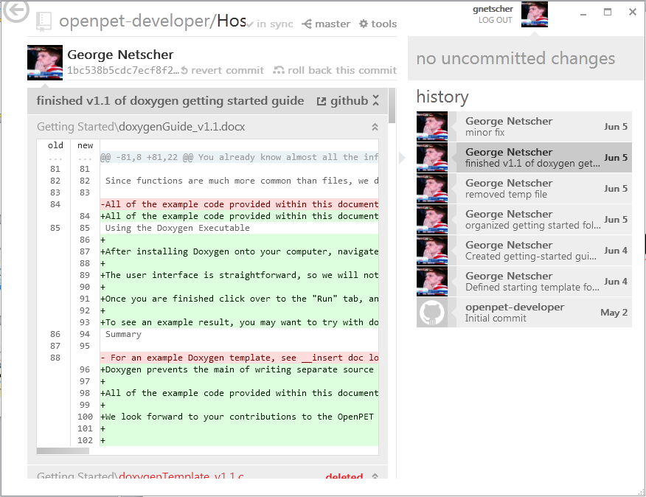
The goal

Slide 3
Setup and Installation

Slide 4
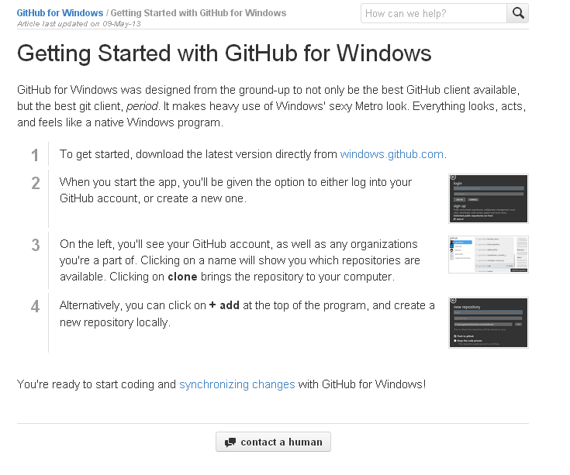

Slide 5
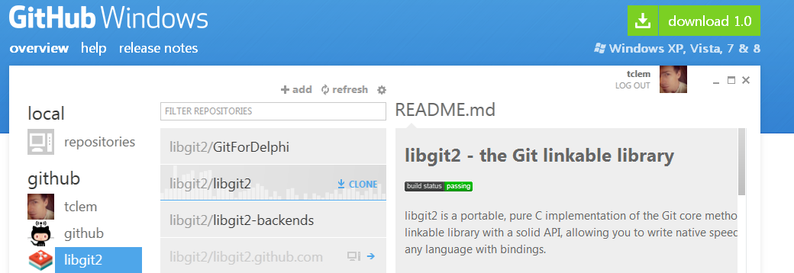

Slide 6
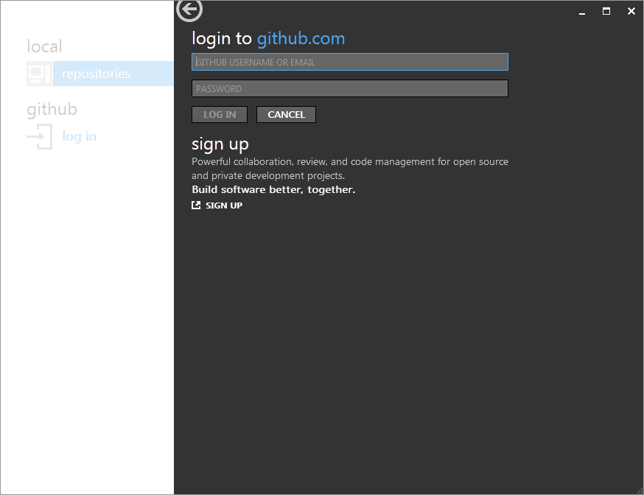

Slide 7
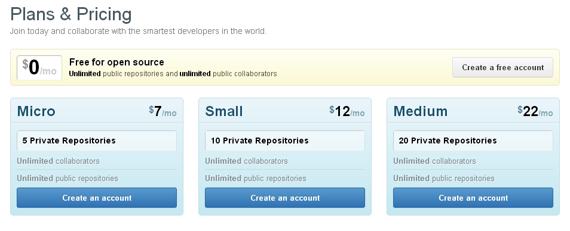

Slide 8
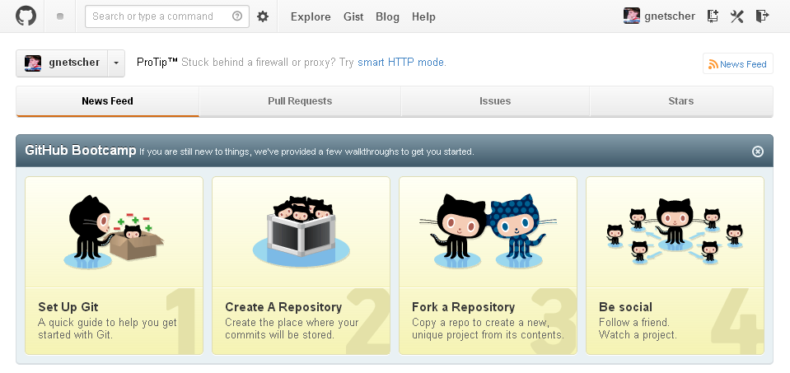

Slide 9
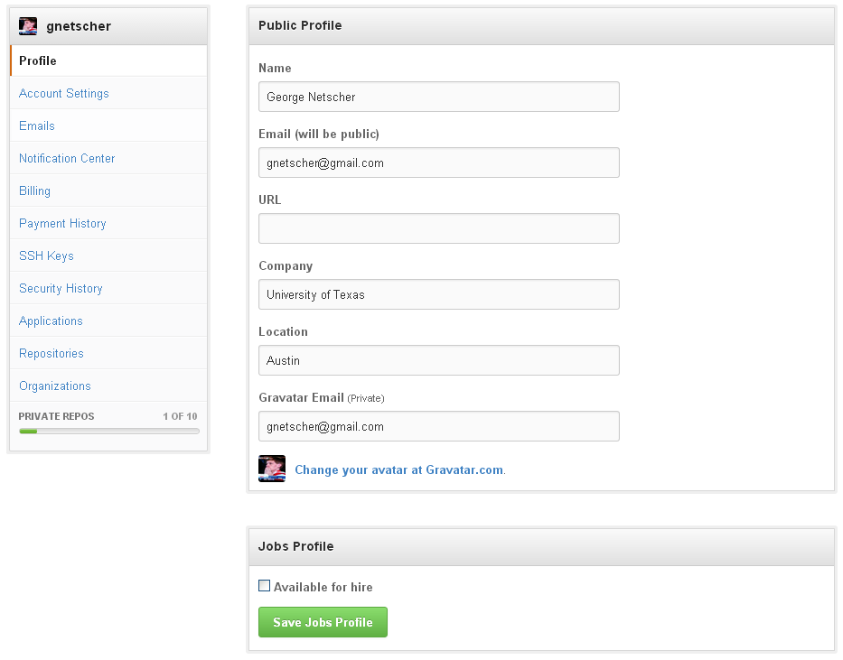

Slide 10
Cloning a Repository
Clone – copy a public repository into a local directory

Slide 11
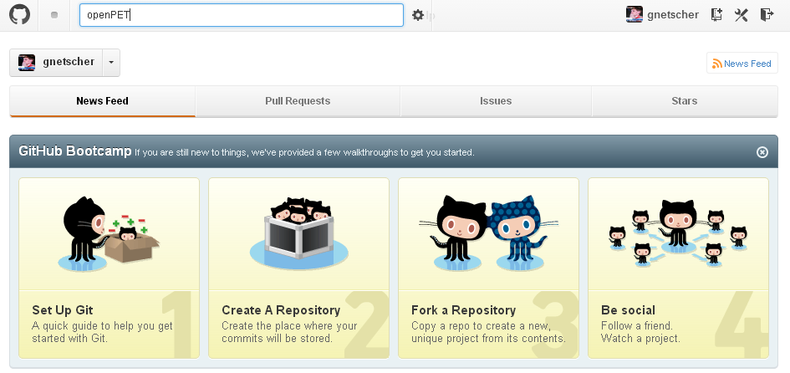

Slide 12
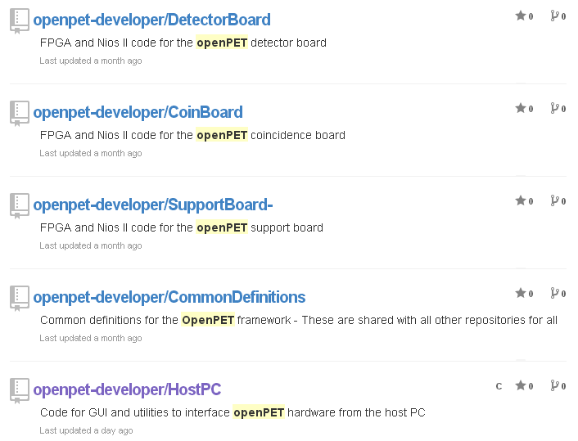
Owner grants collaborator permission
openpet-developer = Martin Judenhofer msjudenhofer@ucdavis.edu
Email with github username for permission

Slide 13
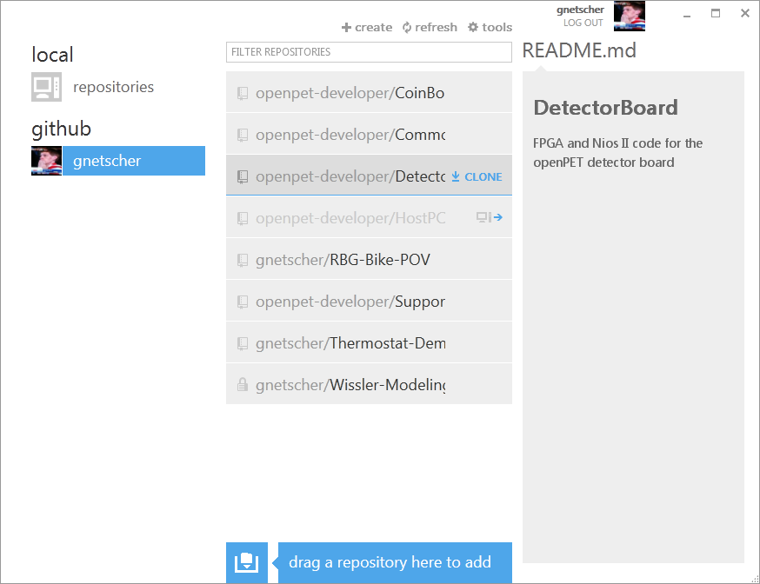

Slide 14
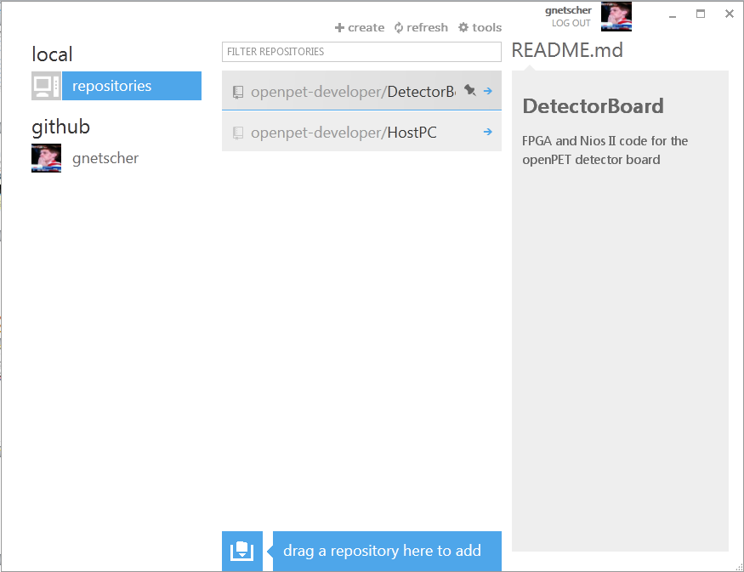

Slide 15
Making Changes
Commit – group changes to local files together with a brief description; preparation for sending back to public repository
Sync – pull repository changes by other contributors to existing local directory & push a commit or a group of commits to the public repository for other contributors

Slide 16
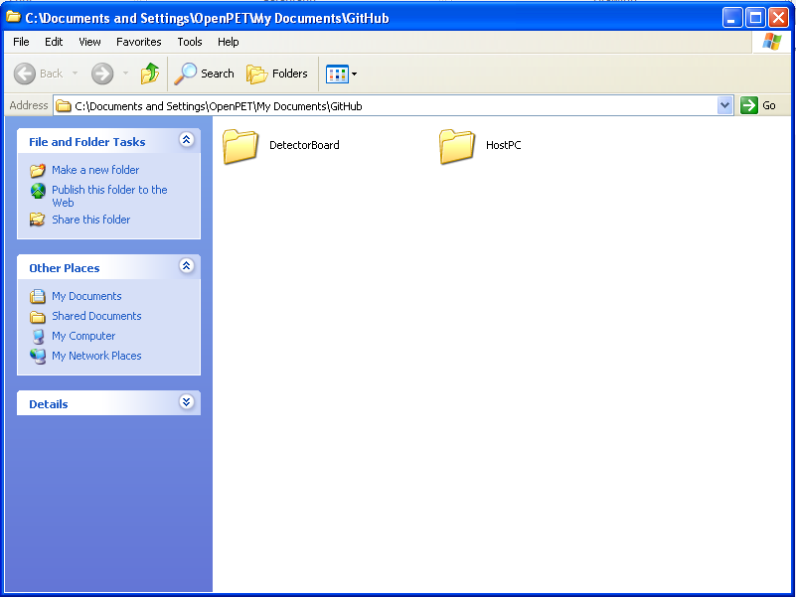
Create and edit documents
in your GitHub folder as you normally would

Slide 17
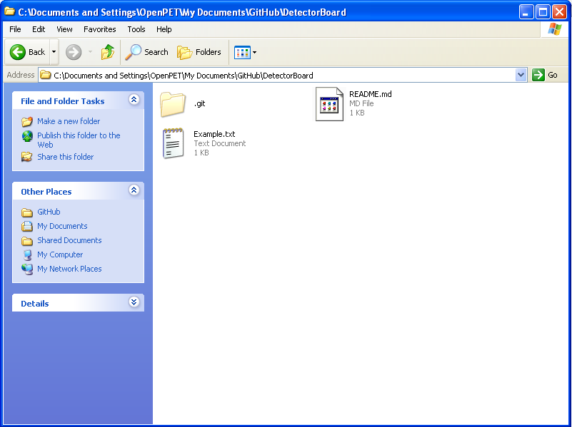

Slide 18
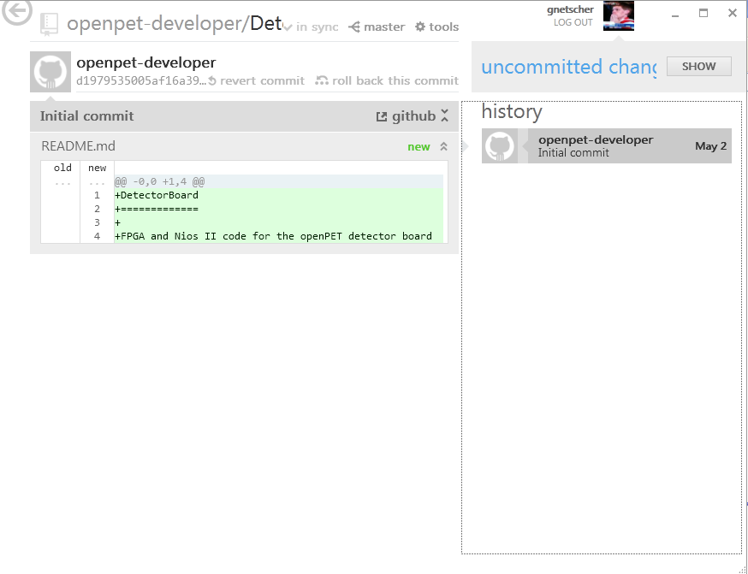

Slide 19
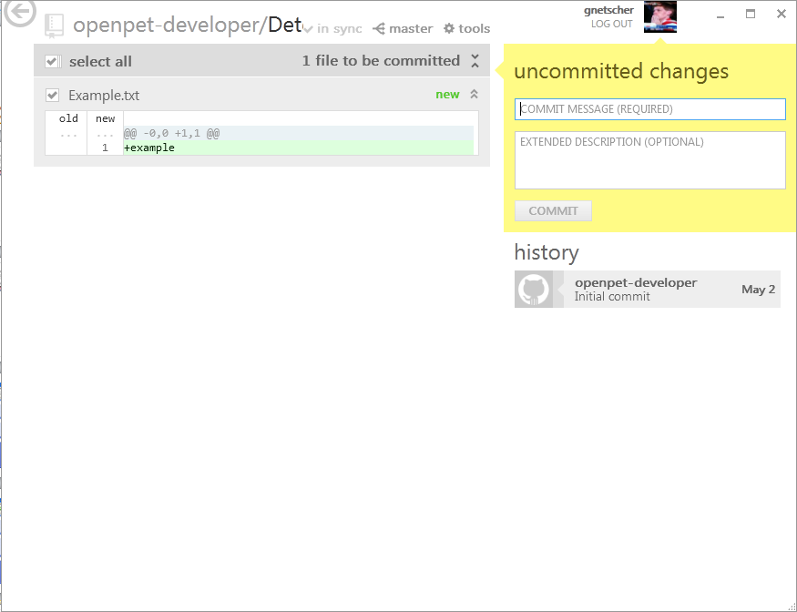

Slide 20
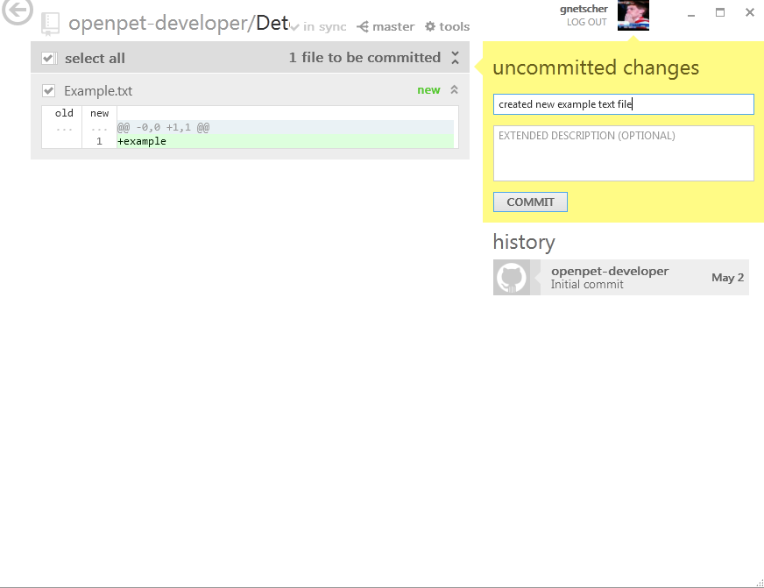

Slide 21
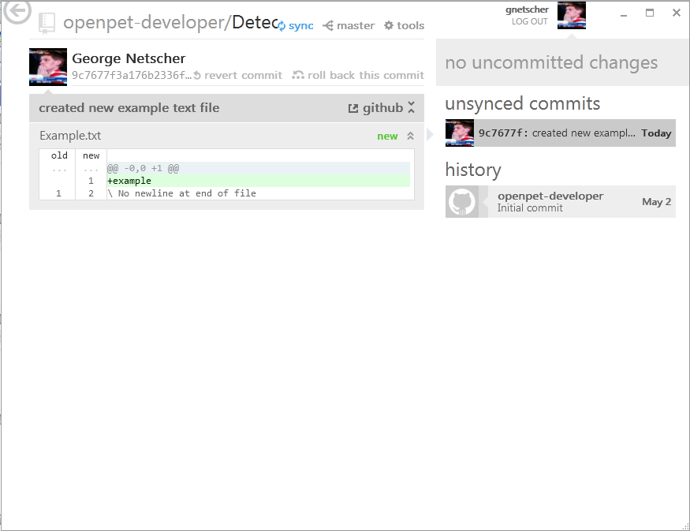

Slide 22
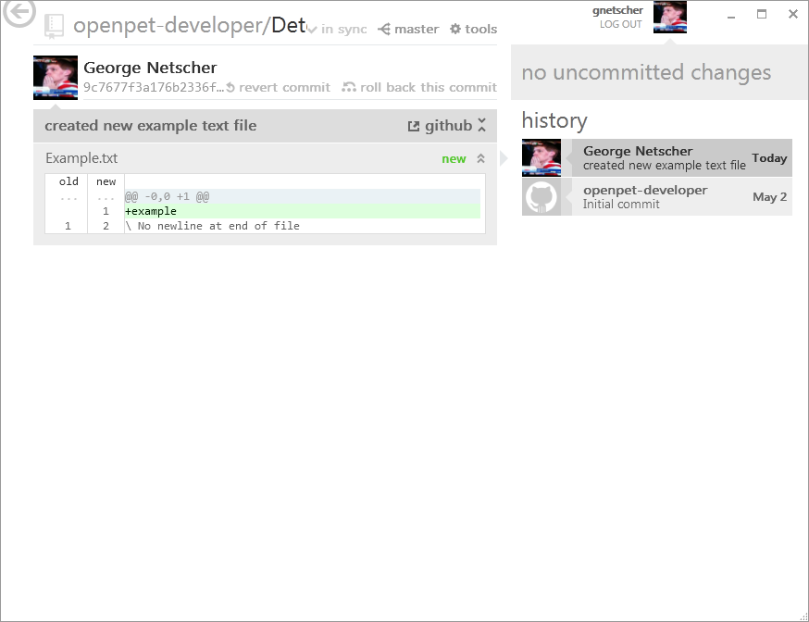
Local changes have now been pushed to public server

Slide 23
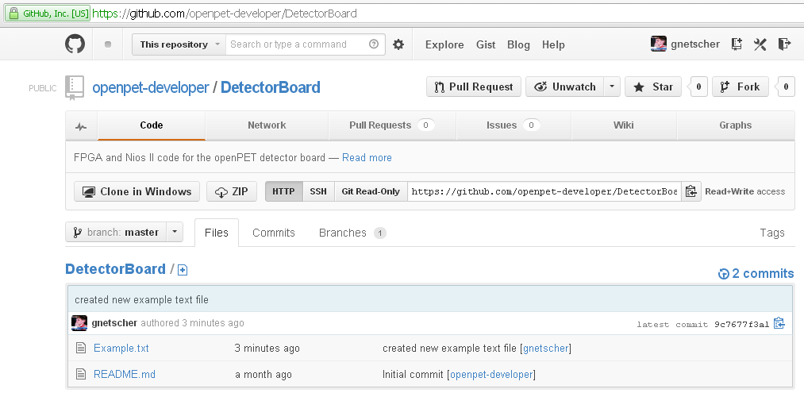
Online repository mirrors changes

Slide 24
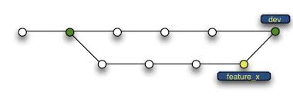
Branching
Branch – copy an existing repository into a new branch; usually to develop a new feature or work out a bug fix

Slide 25


Slide 26
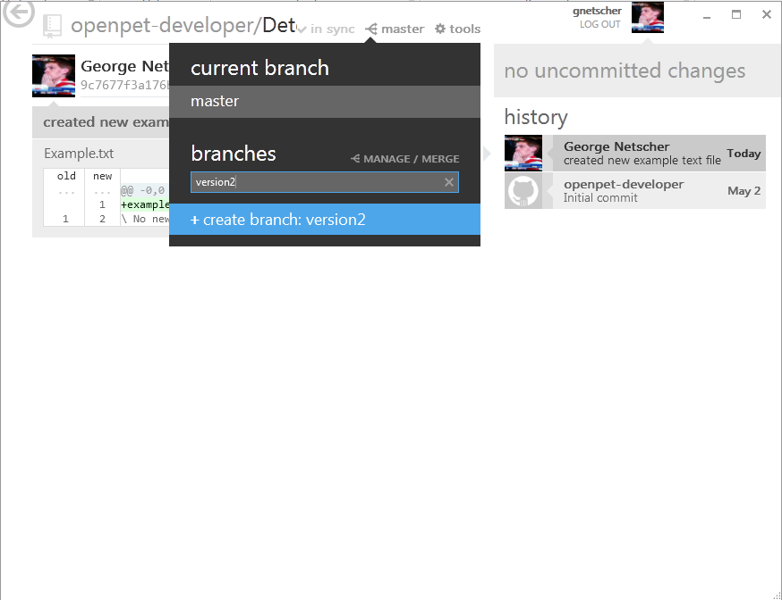

Slide 27


Slide 28
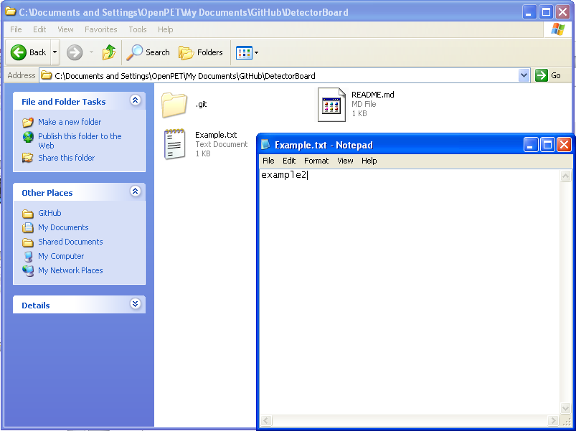

Slide 29
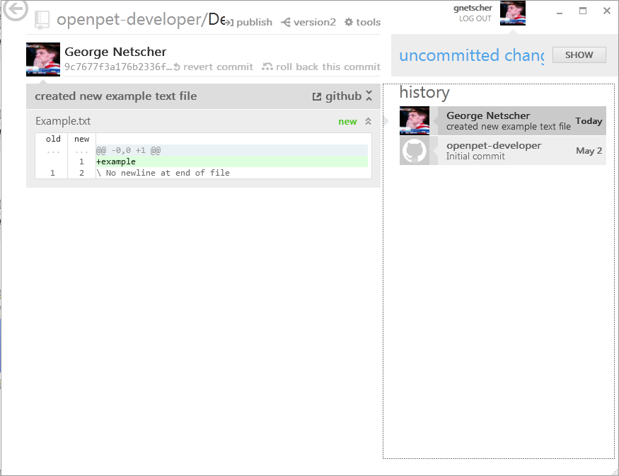

Slide 30
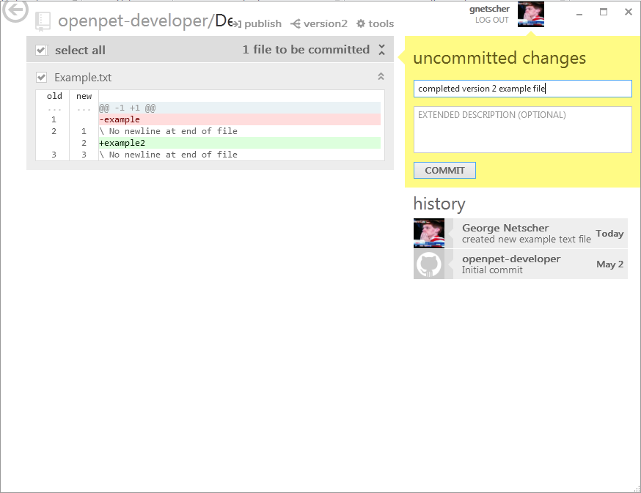

Slide 31
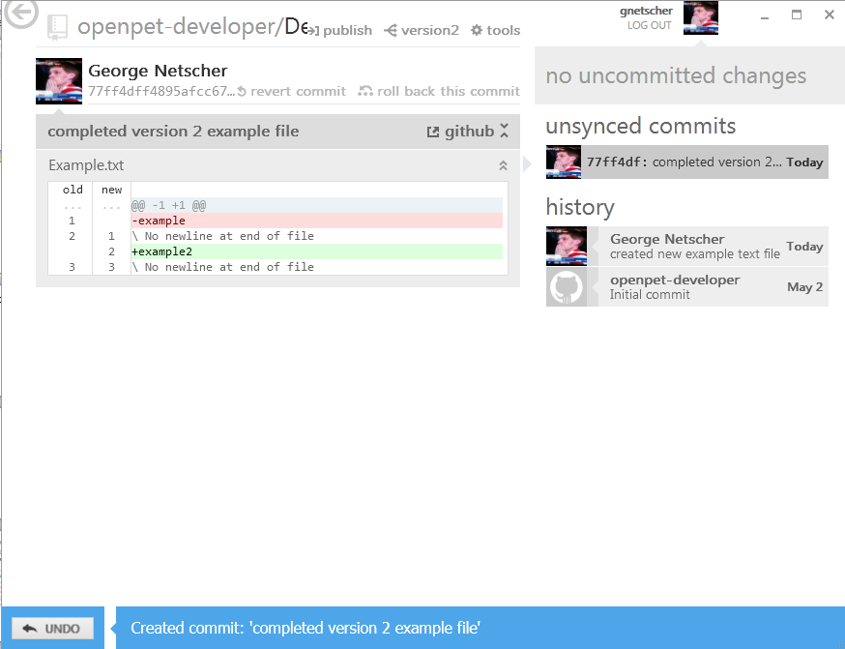

Slide 32
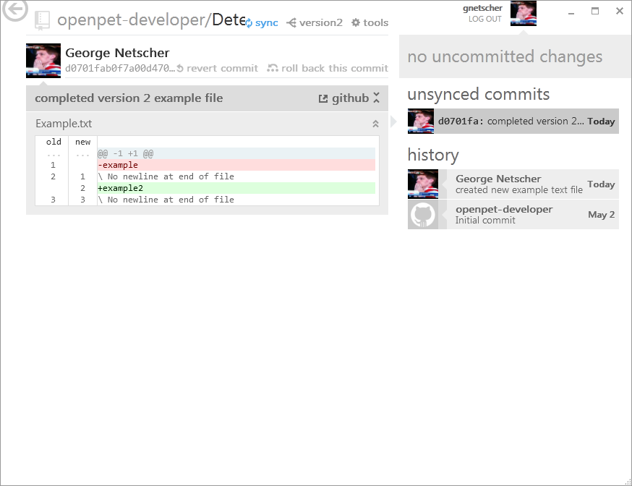

Slide 33
Merging
Merge – combine two branches into one

Slide 34
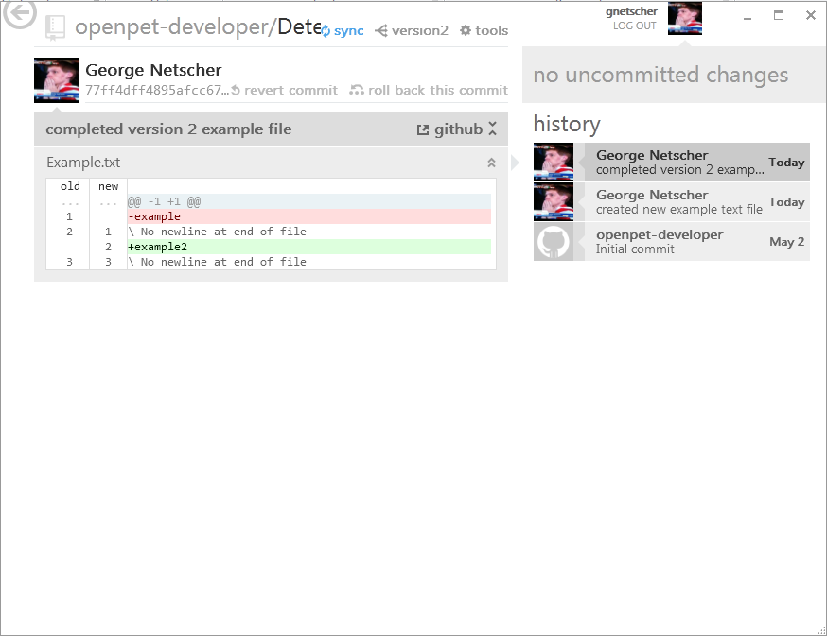

Slide 35
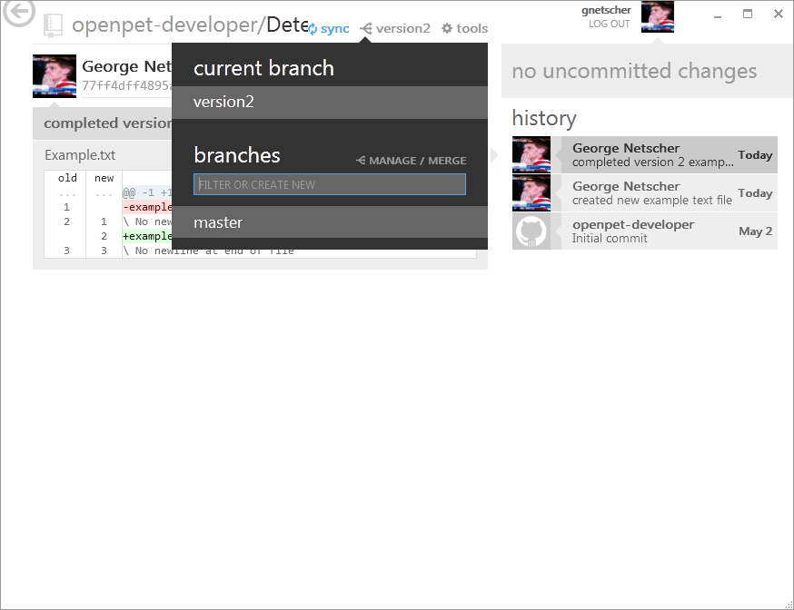

Slide 36
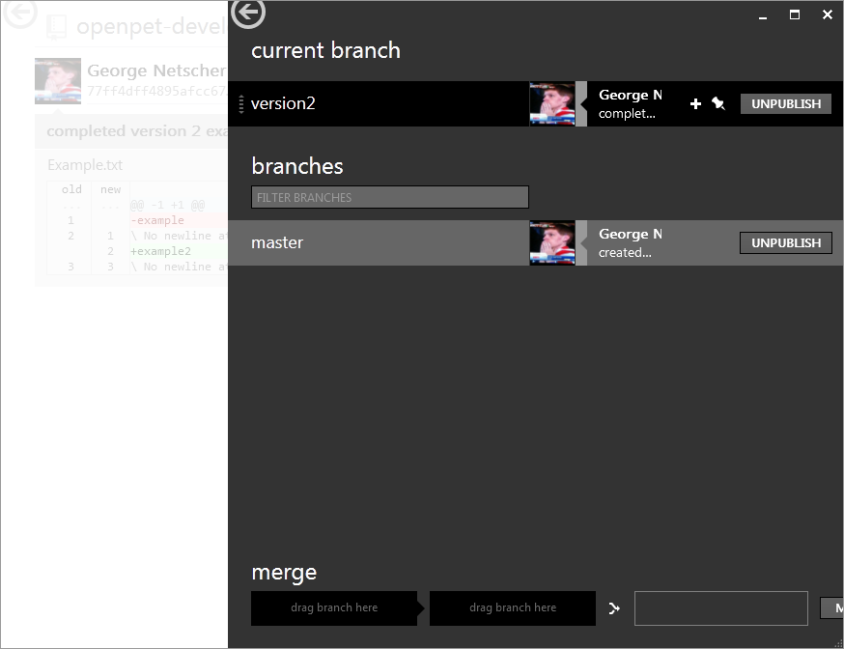

Slide 37
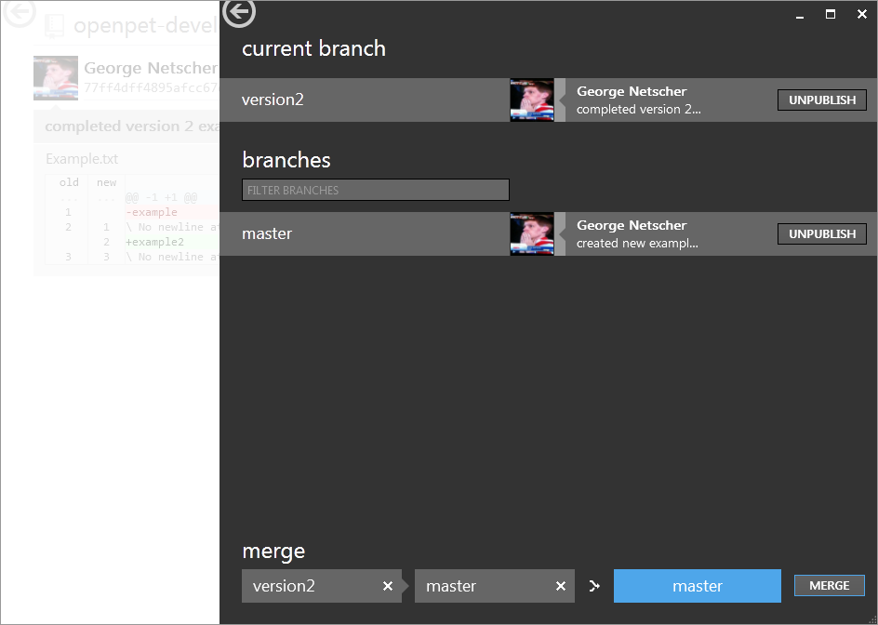
Updated files in this branch…
…will merge with files in this one

Slide 38


Slide 39
Possible Conflicts
Merging 2 different versions of the same file can be tricky
If the same file is modified in 2 different places no error will occur
If the same files is modified in the same place in 2 different ways, an error will occur
See end of slide show for more information

Slide 40
Summary
Clone – copy a public repository into a local directory
Commit – group changes to local files together with a brief description; preparation for sending back to public repository
Sync – pull repository changes by other contributors to existing local directory & push a commit or a group of commits to the public repository for other contributors

Slide 41
Summary
Branch – copy an existing repository into a new branch; usually to develop a new line of thought or work out a bug fix
Merge – combine two branches into one

Slide 42
FAQ

Slide 43
Opensource Community Structure
Users
Collaborators
Owner/
Admin

Slide 44

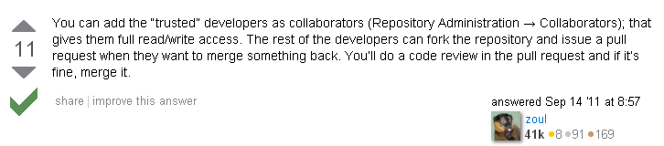

Slide 45
When merging doesn’t go smoothly

Slide 46
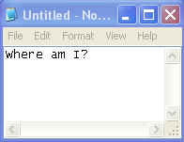
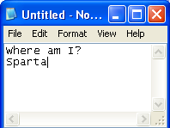
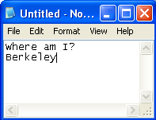
New branch
Branch
“test”
Branch
“master”
?
What happens when I merge?

Slide 47
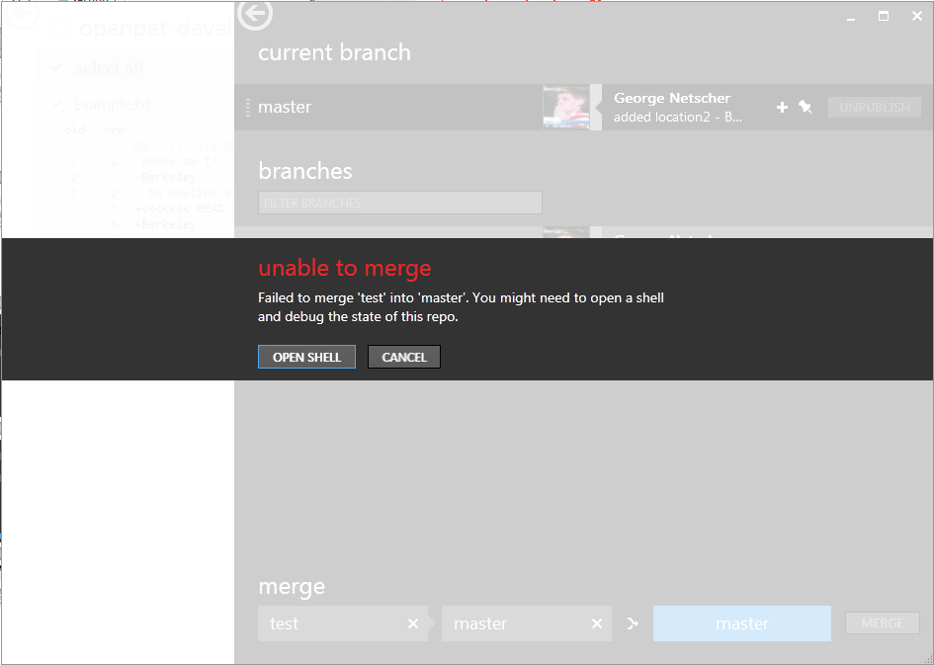
Requires command line interface to solve
http://git-scm.com/book/en/Git-Branching-Basic-Branching-and-Merging

Slide 48
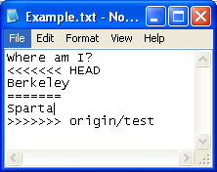
New branch
Branch
“test”
Branch
“master”
Conflict markers are inserted
Conflicts must be resolved manually before merging

